Slide 1

Frogger
ECE 210 Project Presentation
April 27, 2017
Team Members: Keith Chua and Justin Griesemer
Notes:
‹#›

Slide 2
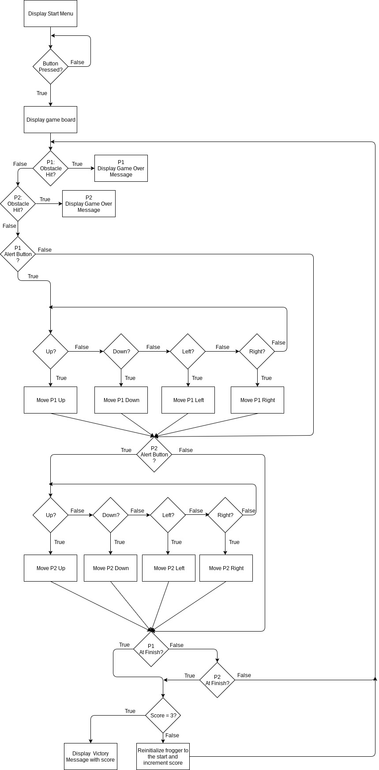
Flowchart

Slide 3
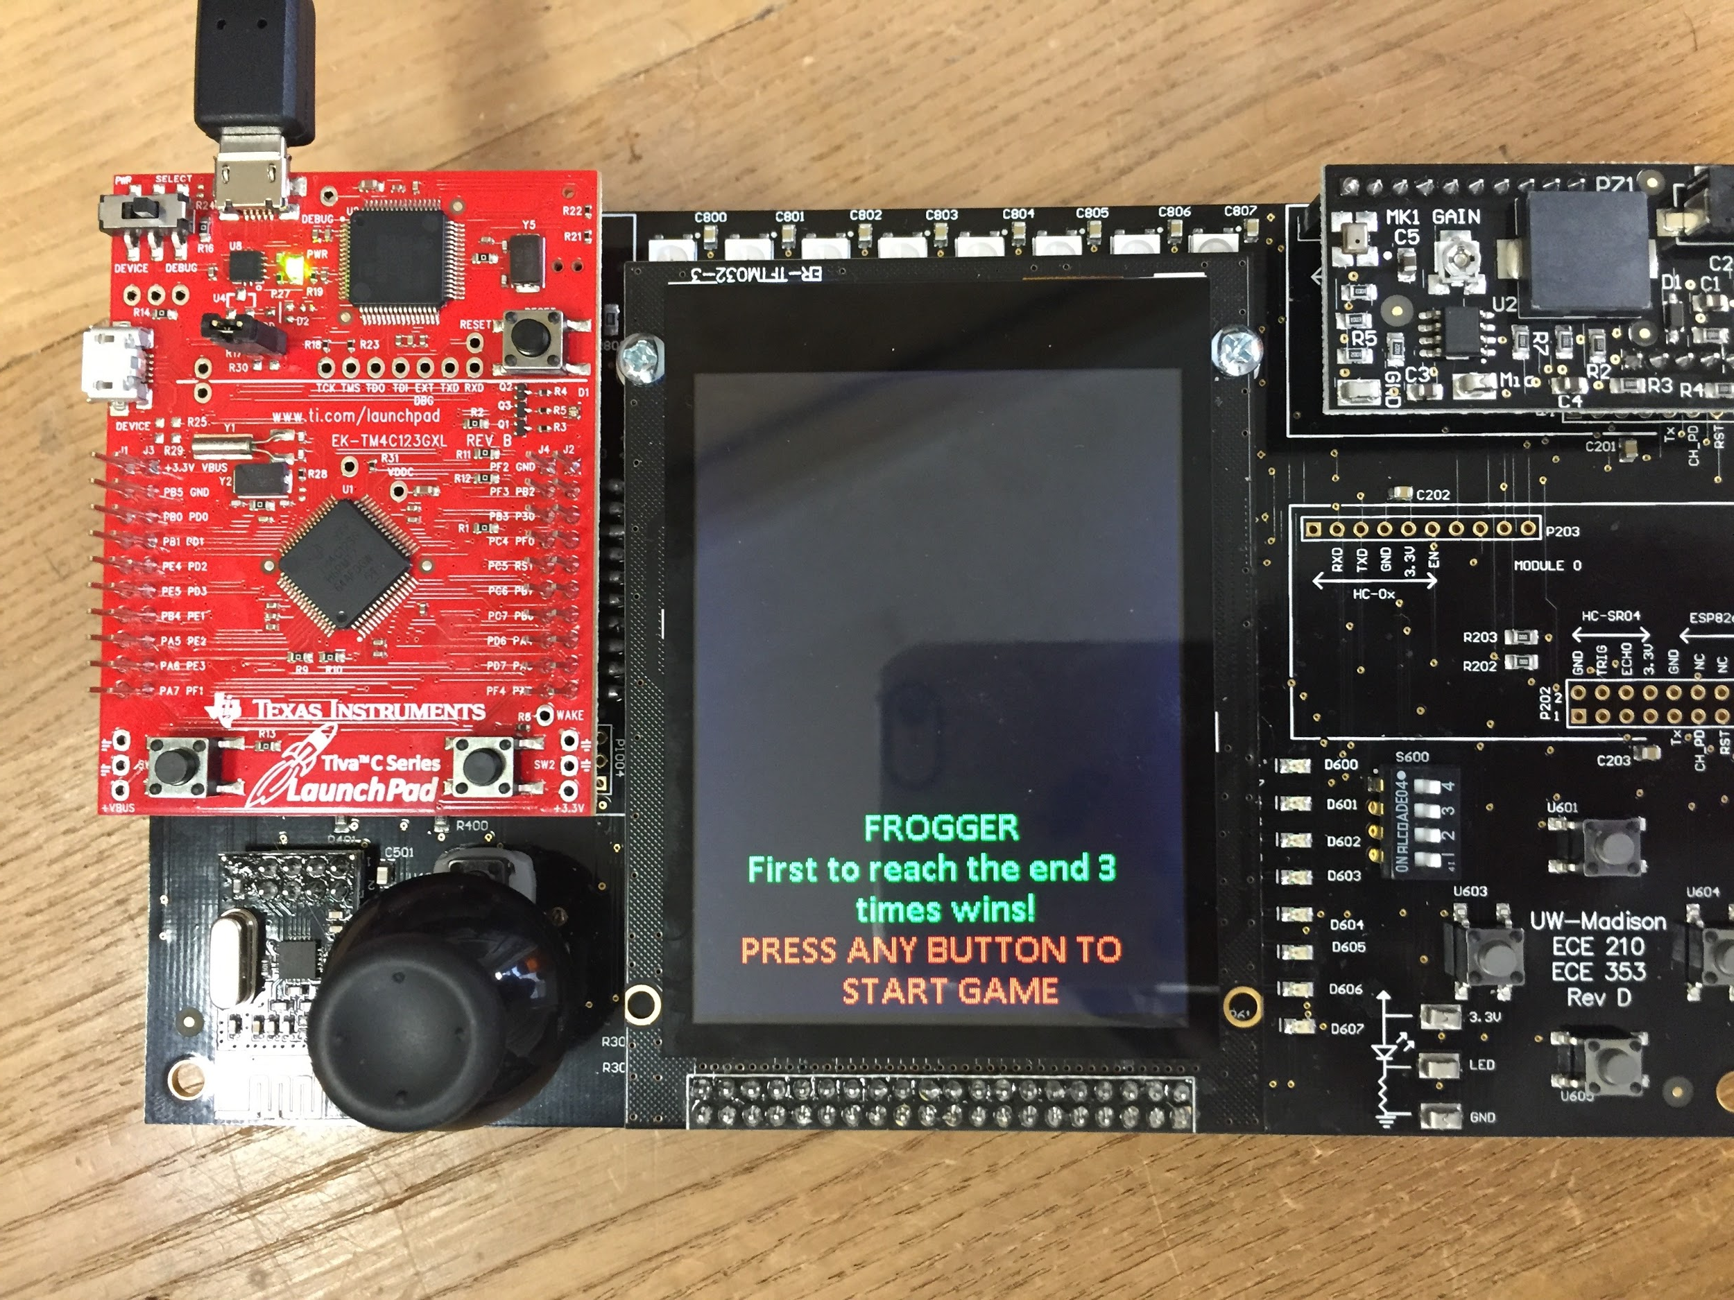
Results

Slide 4
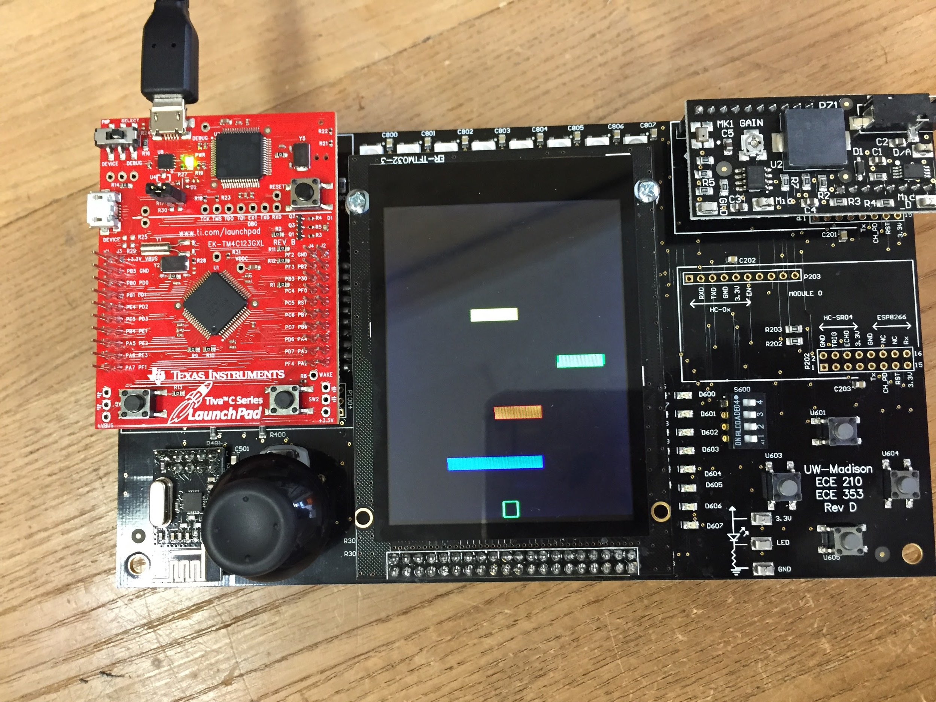
Results

Slide 5
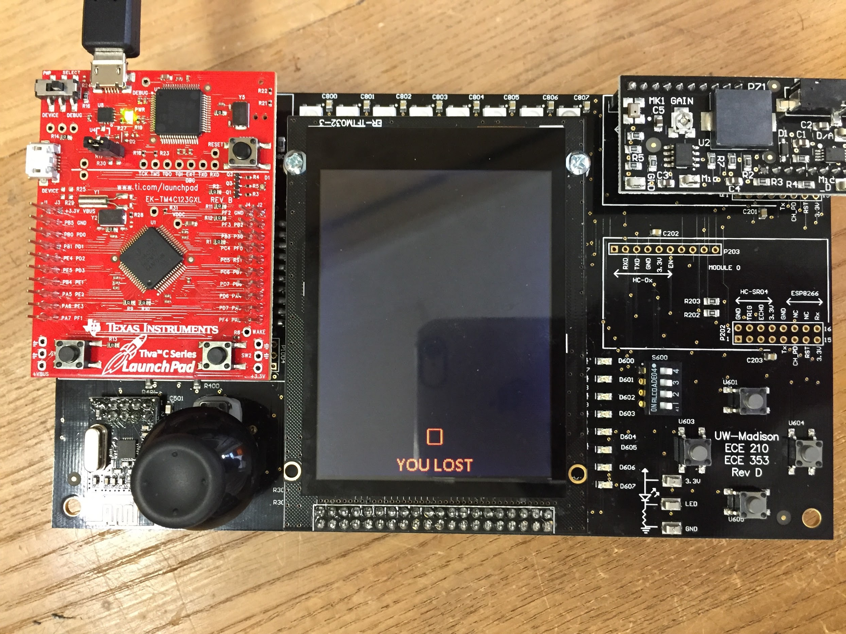
Results

Slide 6
Conclusions
We learned a lot from this project:
How to solder a board correctly
How to code in C
How to design a game
With more time, we could have added many more features to our game:
Animations on death and victory
Design more complicated bitmaps
Sounds and music

